Slide 1

Introducing DevOps and Continuous Integration
Continuous Integration

Slide 2
Different organisations have varying approaches to implementing DevOps.
It is a cultural approach to software development with a particular philosophy designed to achieve:
Increased collaboration
Reduction in silos
Shared responsibility
Autonomous teams
Increase in quality
Valuing feedback
Increase in automation
What is DevOps?

Slide 3
IT Before DevOps
Traditional Software Team Structure
Separate teams:
Development, QA, Security, Operations
Teams develop conflicting goals and poor communication
Leads to siloed working
Result:
Slower releases
Wasted time and cost
Blame culture across teams

Slide 4
DEVOPS AND AUTOMATION:
INTEGRATION, DELIVERY AND DEPLOYMENT
Automation around process is a big part of DevOps,
focuses around three main areas:
Continuous Integration
Integration and testing of new features into software
Continuous Delivery
Deploying safe-working code into a staging environment
Continuous Deployment
Deployment of applications to a customer for usage

Slide 5
Continuous Integration, Delivery, Deployment
Continuous Integration
Continuous Delivery
Continuous Deployment
Is a software dev practice that revolves around merging changes often
Different features are combined, or integrated, frequently and deployed
Automating the integration of code, the building of software, and testing of software is key
Extends on CI, ensuring that you can release new changes to customers quickly
We automate the deployment to a staging environment – an environment that mimics the production environment as closely as possible
Once we’ve verified that it works, it should work in a production
Extends even further on Continuous Delivery, automating deployment into a customer-facing environment
This is quite often the difficult and stressful task!
If anything is wrong with a feature, it could be seen by customers

Slide 6
Continuous Integration, Delivery, Deployment
Continuous Integration
Continuous Delivery
Continuous Deployment
Is a software dev practice that revolves around merging changes often
Different features are combined, or integrated, frequently and deployed
Automating the integration of code, the building of software, and testing of software is key
Extends on CI, ensuring that you can release new changes to customers quickly
We automate the deployment to a staging environment – an environment that mimics the production environment as closely as possible
Once we’ve verified that it works, it should work in a production
Extends even further on Continuous Delivery, automating deployment into a customer-facing environment
This is quite often the difficult and stressful task!
If anything is wrong with a feature, it could be seen by customers

Slide 7
Continuous Integration, Delivery, Deployment
Continuous Integration
Continuous Delivery
Continuous Deployment
Is a software dev practice that revolves around merging changes often
Different features are combined, or integrated, frequently and deployed
Automating the integration of code, the building of software, and testing of software is key
Extends on CI, ensuring that you can release new changes to customers quickly
We automate the deployment to a staging environment – an environment that mimics the production environment as closely as possible
Once we’ve verified that it works, it should work in a production
Extends even further on Continuous Delivery, automating deployment into a customer-facing environment
This is quite often the difficult and stressful task!
If anything is wrong with a feature, it could be seen by customers

Slide 8
Exercise
CI research
In groups, research online about a company that utilises DevOps, CI and CD principles within their business
Note down who the business are, what their main trade/service is, etc.
Answer the following questions where possible:
Why did the business adopt CI/CD?
How has it improved their development processes?
What tools do they use that you recognise, if any?
Share your research and thoughts with the rest of the room

Slide 9
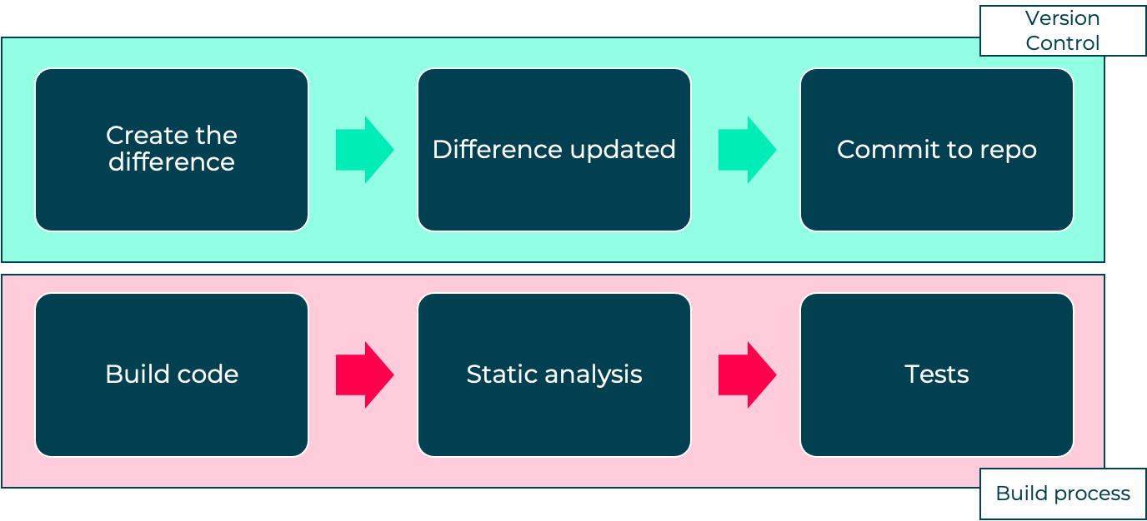
Facebook at Scale (Case Study)
Engineering scale:
Multiple teams: Messaging, Photos, Android, iOS, Events
100,000+ commits in the Git repository
300+ contributors working across 150,000+ files
CI in Action
Facebook
Notes:
Facebook is one of the largest social media platforms with billions of mobile users
In 2014, Christian Legnitto shared how Facebook built its mobile platform

Slide 10
End of section

